Slide 1
Module 1 Process Model
Roger S. Pressman
Chapter 2

Slide 2
Process Model
a process was defined as a collection of work activities, actions, and tasks that are performed when some work product is to be created.
Each of these activities, actions, and tasks reside within a framework or model that defines their relationship with the process and with one another
generic process framework for software engineering defines five framework activities—communication, planning, modeling, construction, and deployment. In addition, a set of umbrella activities—project tracking and control, risk management, quality assurance, configuration management, technical reviews, and others
Types:
A linear process flow executes each of the five framework activities in sequence, beginning with communication and culminating with deployment (Figure 2.2a).
An iterative process flow repeats one or more of the activities before proceeding to the next (Figure 2.2b).
An evolutionary process flow executes the activities in a “circular” manner. Each circuit through the five activities leads to a more complete version of the software (Figure 2.2c).
A parallel process flow (Figure 2.2d) executes one or more activities in parallel with other activities (e.g., modeling for one aspect of the software might be executed in parallel with construction of another aspect of the software).

Slide 3
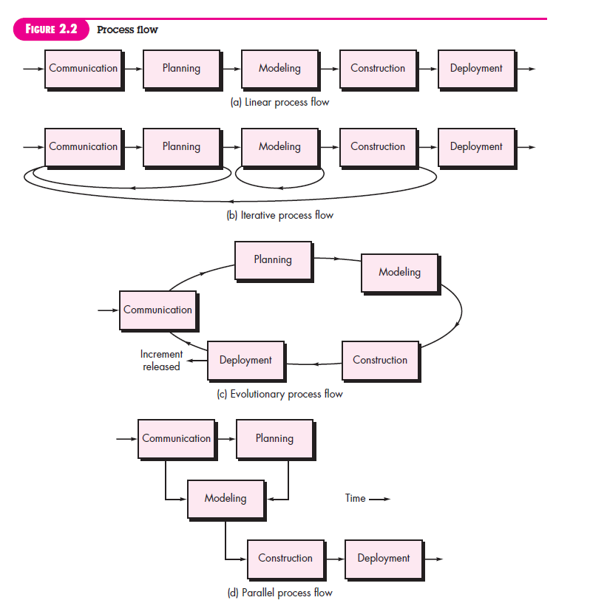

Slide 4
1. Waterfall model
Developed in the 1970s by Winston W. Royce.
Inspired by manufacturing and construction processes, where each step relies on the completion of the previous one.
It is a simplest SDLC in which phases are organised in a linear and sequential order.
It is called waterfall model as its diagrammatic representation resembles as like a waterfall, also known as classical life cycle model.
This type of model is basically used for the Small to medium-sized projects with clear, well-defined requirements. When the technology and tools to be used are wellknown and stable.

Slide 5
Advantage
Easy to understand
Each phase has well defined input and output, phases are processed and completed one at a time. Phases do not overlap.
Low cost and easy to schedule, as all staff do not work concurrently on the same project, so can work on different projects.
The waterfall model is the oldest paradigm for software engineering
Disadvantage
Not suitable to accommodate any change or iteration once development has begun. It is always difficult to acquire of the requirement in the starting.
Working version is produced in the last level, so not good for large size sophisticated projects.
High amounts of risk and uncertainty.
Real projects rarely follow the sequential flow that the model proposes
No feedback, no experiment, no parallelism, Rigid

Slide 6
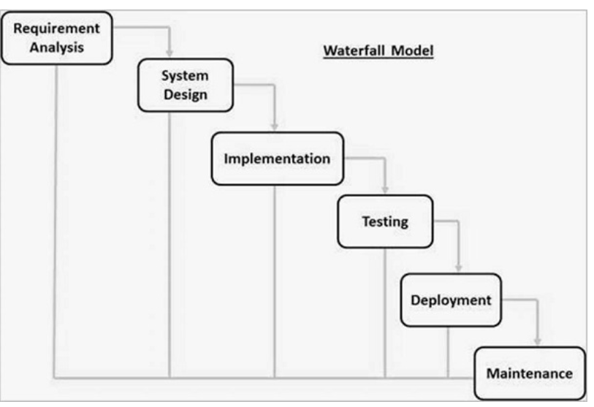
Waterfall Model

Slide 7
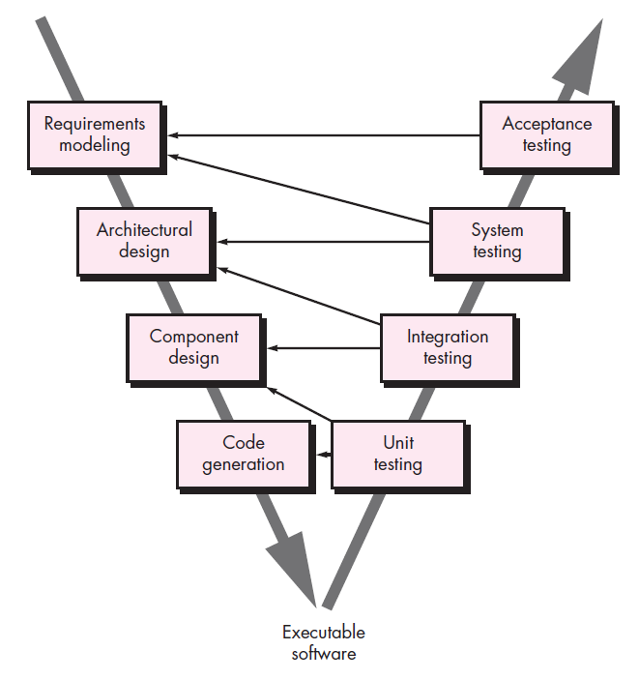
2. V-shaped model
A variation in the representation of the waterfall model is called the V-model
left side of the V, basic problem requirements are refined into progressively more detailed and technical representations of the problem and its solution.
Once code has been generated, the team moves up the right side of the V,
In reality, there is no fundamental difference between the classic life cycle and the V-model. The V-model provides a way of visualizing how verification and validation actions are applied to earlier engineering work

Slide 8
V-shaped model
Also known as verification & validation model
Testing is associated with every phase of lifecycle.
Verification phase (requirement analysis, system design, architecture design , module design)
Validation phase (various testing)
Basically, testing is done parallelly
Testing is the main thing in V-shaped model

Slide 9
V-shaped model
Advantage
Time saving (because of the parallelism)
Every component is tested
Progress can be tracked easily
Proactive defect tracking
Disadvantage
No feedback
Risk analysis is not done
Not practical for big project.

Slide 10
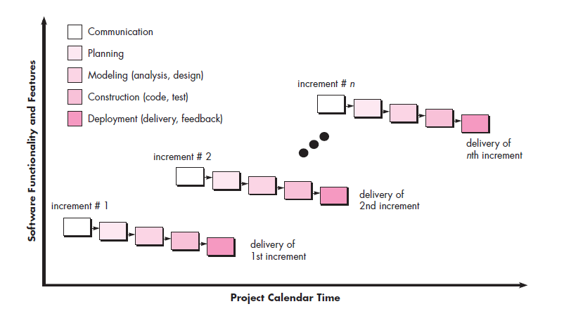
3. Incremental Process Models
There are many situations in which initial software requirements are reasonably well defined, but the overall scope of the development effort precludes a purely linear process
The incremental model combines elements of linear and parallel process flows

Slide 11
Incremental Process Models
Which part is build first?
The high-risk or major functions are built first
What does each release deliver?
An operation product
Can customer use the released product?
Yes, they can. It has maximum customer interaction.
Is the cost very high for this model?
Yes, because of multiple releases.
When staff are not available for a complete implementation
Most of the requirements are expected to evolve over time
Projects which have lengthy development schedules

Slide 12
4. Evolutionary Process Models
Context: Software, like all complex systems, evolves over a period of time, Business and product requirements often change as development proceeds, making a straight line path to an end product unrealistic
Evolutionary models are iterative. They are characterized in a manner that enables you to develop increasingly more complete versions of the software
Combination of Iterative + incremental model
Here, customer can change their requirement, unlike incremental model.
Incremental model first implement a few basic features and deliver to the customer. Then build the next part and deliver it again and repeat this step until the desired system is fully realizes.
Here, along with Incremental model, feedbacks are also collected from the customer and added.
NOT suitable for small project.

Slide 13
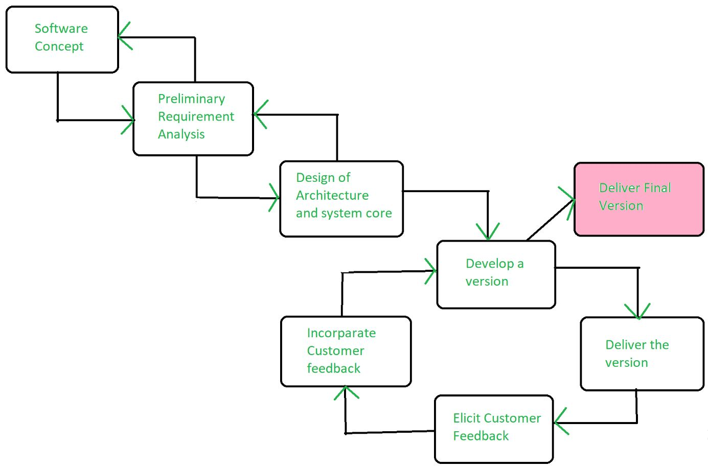

Slide 14
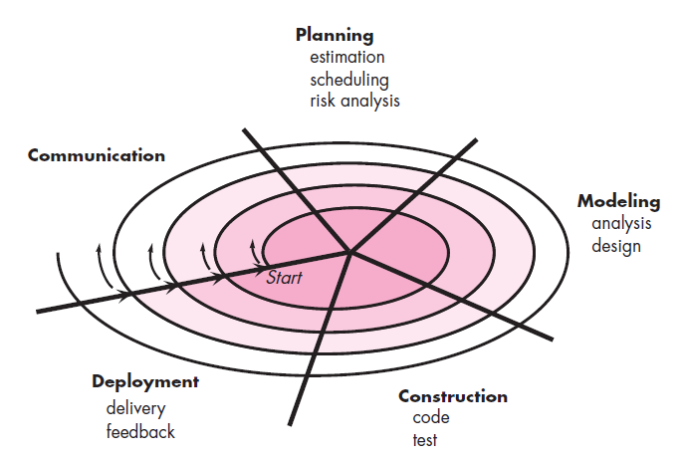
5. Spiral Model
RISK ANALYSIS

Slide 15
Spiral Model
Advantage:
Risk analysis
For large project
Flexible
Customer Satisfaction
Disadvantage:
Suitable for very complex project
Expensive
Too much risk analysis
Time taking
Terminologies:
Risk handling
Radius of spiral
Angular Dimension
Meta model

Slide 16
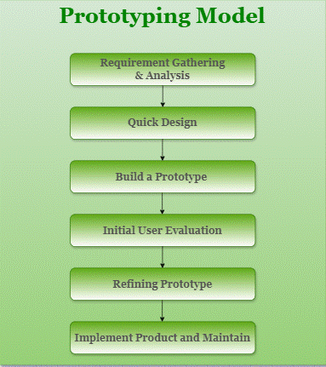
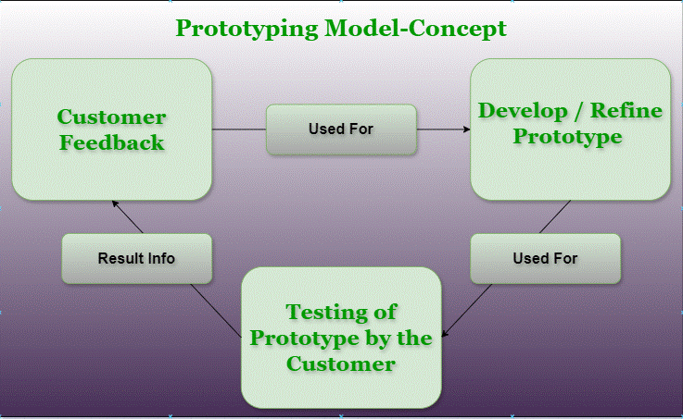
Prototyping Model

Slide 17
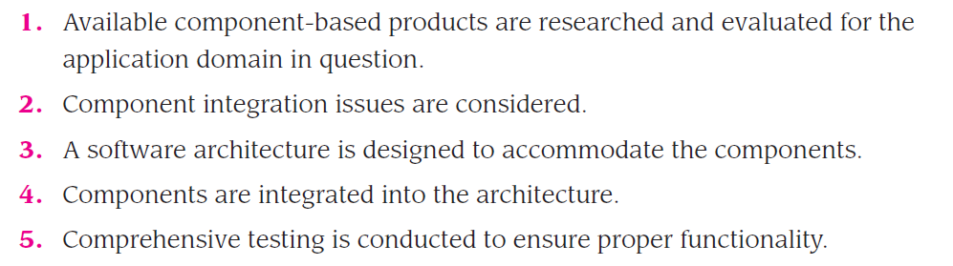
Component-Based Development
Template or Description
Reuses the components, that already exists
Increases reusability of individual SW components which are already tested and verified.

Slide 18
Component-Based Development
Key points
The component-based development model incorporates many of the characteristics of the spiral model; It is evolutionary in nature [Nie92], demanding an iterative approach to the creation of software. However, the component-based development model constructs applications from prepackaged software components
The component-based development model leads to software reuse, and reusability
software engineering team can achieve a reduction in development cycle time,
reduction in project cost if component reuse becomes part of your culture

Slide 19
Previous Year Question
You are interacting with the MIS department of a very large oil company with multiple departments. They have a complex regency system. Migrating the data from this legacy system is not an easy task and would take a considerable time. The oil company is very particular about processes, acceptance criteria and legal contracts
. Answer the following questions. (2 marks)
Which model is best suited and, justify? (8 marks)
Regency: jurisdiction, or government of a regent or body of regents.

Slide 20
